Slide 1
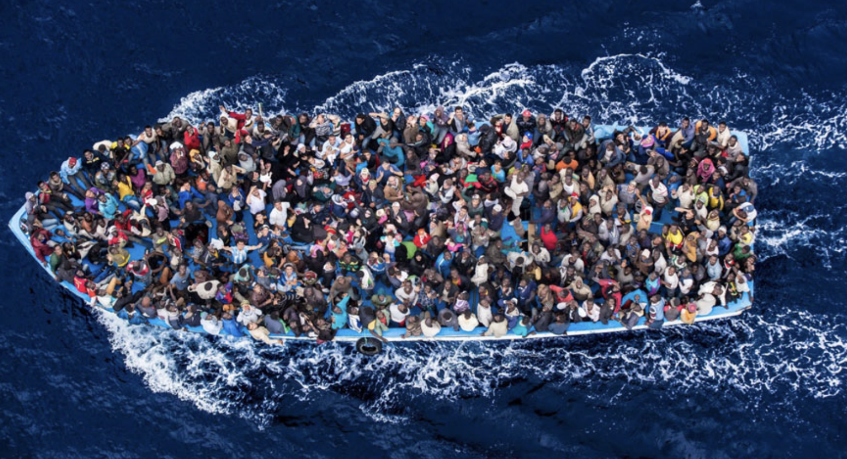
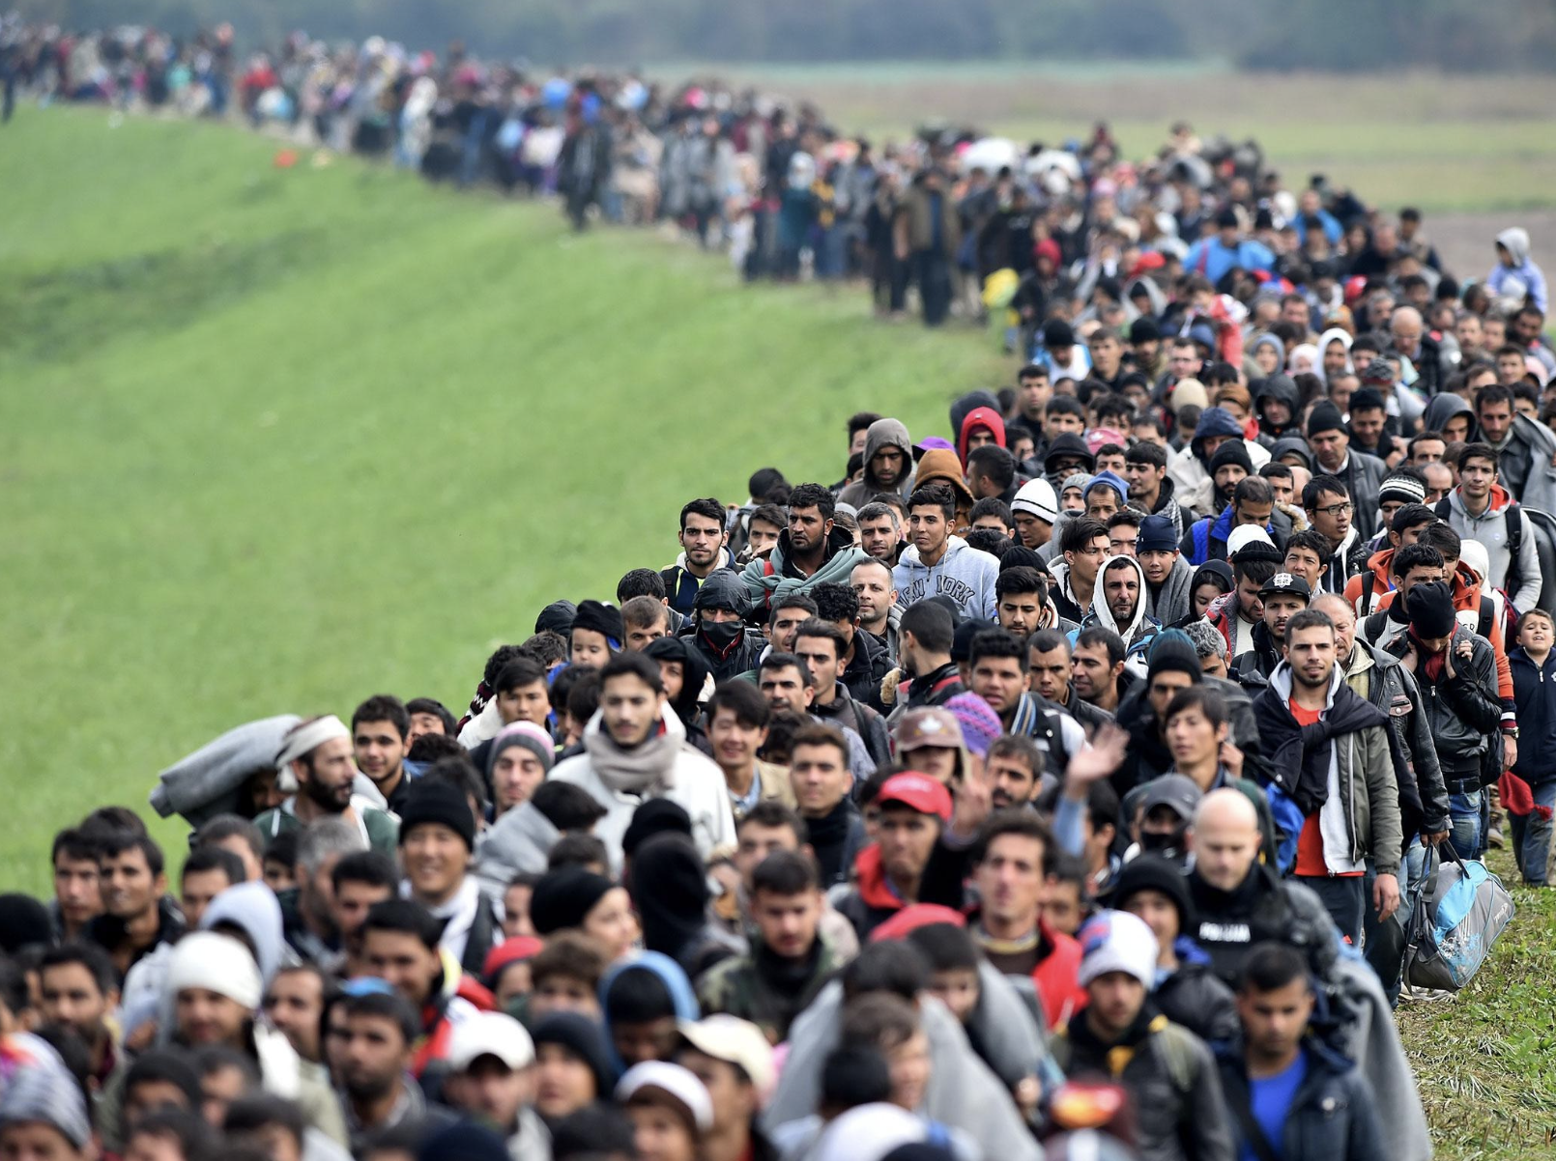
Weaponization of Migration Flows
CMPS 6730: Natural Language Processing
Baris Alan
PhD Candidate in Political Science

Slide 2
Research Question
Broader Importance
Goal:
create a model to detect threatening language around migration by Turkey
Broader: by transit migration countries
Significance:
migration as the last puzzle of globalization
global migration disturbs politics, economy, society in sending-receiving-transit
migrants stuck in transit countries
IR – IPE Literature on Asymmetric Conflicts
Weak actors are doomed to be coerced/co-opted → no space for agency
However, cross-border population movements → as a new coercive tool available to weak actors
Weaponization of mass migration by Libya and Turkey

Slide 3
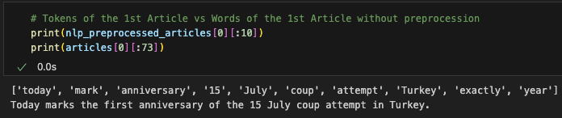
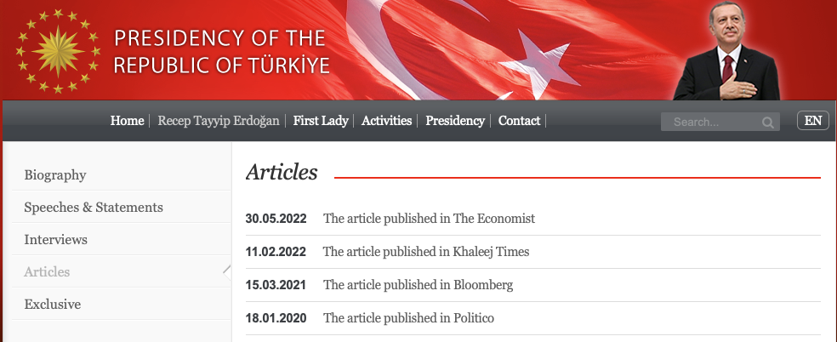
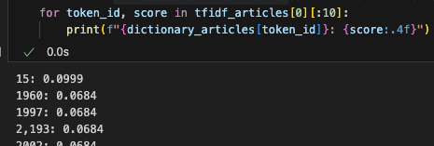
Data
Data Pre-processing
Turkey:
Speeches/articles/interviews by Turkish President
Other countries:
MFA press releases/Q&As
Data Extraction
Web scraping using BS4
Data Preprocessing: Spacy small model
Vectorization: Gensim tfidf model
Topic Modeling: Gensim LDA

Slide 4
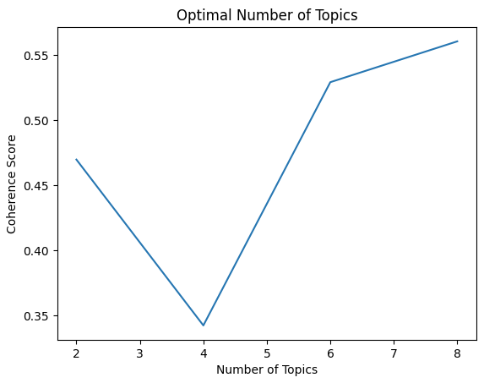
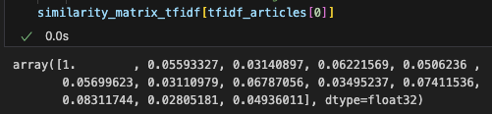
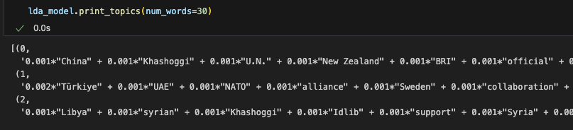
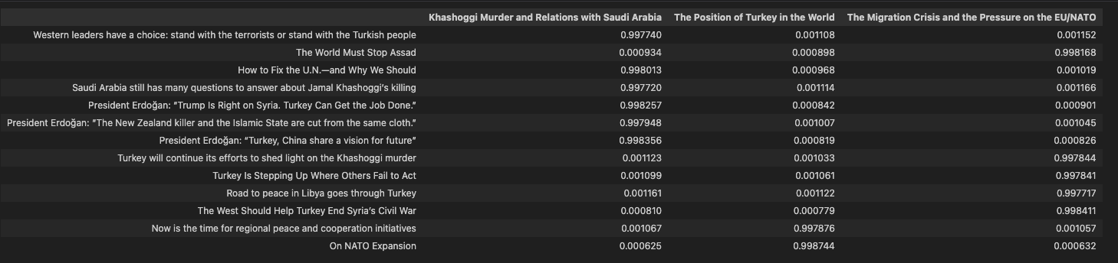

Slide 5
Future Analysis
Fundamental Approach:
Paragraph-level analysis
manually label 10-15% of data
Prediction model to predict rest
Topic Modeling (LDA and HAD)
To compare/complement fundamental
Fine-Tuned Classification Model
Transformers-based BERT and XLM-RoBERTa
Models for multi-language models
bert-base-multilingual-cased
xlm-roberta-base

Slide 6
Conclusion and Caveats
Goal: create a classification model to detect threatening language around migration
Broader: DV for a broader project
Apply this model to all transit migration countries since 2007
The effect of network centrality and domestic resources on WOM

